Slide 1
Enhancing National University Network Security: Attack Simulation & Cybersecurity Awareness
Diploma Project – Computer Engineering (Cybersecurity), Middle East College
Done by :
Laila Tamer Mekhimar - (23F24083)
Hamza Suleiman Aladawi – (23F24607)
Sheikha Rashid Al Hinai – (23F24676)
Taha Mohammed Al Balushi – (23F24590)
Yamen Hamed Al Dhanki - (23S23781)
Guided by :
Ms. IBTISAM AL QARI

Slide 2

Problem Definition
Universities are prime targets for cyberattacks due to their large stores of sensitive data
Traditional classroom teaching fails to give students and staff hands-on experience
Our project bridges this gap with a Cisco Packet Tracer simulation lab
Aligns to Oman Vision 2040 by building digital resilience

Slide 3

Current Cyber Threats
General Issues:
Rising phishing, malware, DoS and ARP spoofing attacks
No hands-on cybersecurity training at NU
Lack of a centralized platform for threat awareness
Outdated security measures unable to meet modern threats
Specific Problems:
No lab for simulating real attacks
Limited VLAN/ACL/firewall practice
Insufficient training in spotting and mitigating threats

Slide 4
Project Overview
Developed a Cybersecurity Awareness and Attack Simulation Lab using Cisco Packet Tracer.
Goal: Strengthen National University’s network security through simulation and training.
Addresses current challenges by offering:
Awareness pages on a dedicated website
An interactive dashboard
Educational YouTube videos
Empowers students and staff with practical digital protection strategies.
Built a layered network architecture (Core, Distribution, Access) for scalability and security.
Integrated security features aligned with university-specific needs.
Equips learners with real-world skills to identify and defend against cyber threats.

Slide 5
Project Aims & Objectives
Aim: Build a hands-on Cybersecurity Awareness and Attack Simulation Lab using Cisco Packet Tracer.
Objectives:
1
2
3
4
5
Simulate phishing, malware, DoS and MITM attacks
Design a VLAN-segmented network with core/distribution/access layers
Implement ACLs, port security, HSRP, DHCP snooping, SNMP & SSH
Develop an interactive dashboard and awareness webpage
Train students and staff to detect and respond to threats

Slide 6
Scope of Implementation
Virtual network with 8 departmental VLANs + management VLAN
Core services: DHCP, DNS, Web, Email
Security features: ACLs, Firewalls, IDS, Port Security, NAT, SNMP
Deliverables: Packet Tracer lab files, web-based training page, video demos

Slide 7
Project Literature Review
Integrated Cyber Training (CyTrONE) – hands-on framework (Beuran et al., 2018)
Delphi-based training models – structured curriculum design (Chowdhury et al., 2021)
Game-based cybersecurity – engaging learning methods (Jin et al., 2018)
Review of training strategies – best practice guidelines (Prümmer et al., 2023)

Slide 8
Methodology
Seven‑phase SDLC
• Planning • Analysis • Design • Development • Testing • Deployment
• Maintenance
Agile Model
• Iterative sprints with rapid feedback
• Flexible adaptation of lab scenarios

Slide 9
Hardware Component
Router (Cisco 2911)
Core Switch (Cisco 2960)
Access Switches
Access Points
Servers (DHCP, DNS, Mail, Web)
Workstations (PCs)
Software Component
Packet Tracer
Windows/Linux OS
Kali Linux
DHCP Service
DNS Service
Email Service
Web Server (HTTP)
Wireshark
SNMP Configuration
Port Security Configuration
MS Visio
YouTube
Requirement Specification
Learning Module / Tutorial
Fundamentals of Computer Networking (Microsoft Learn)
YouTube Tutorial: Networking Project Simulating Network Design Using Cisco Packet Tracer and Cybersecurity Attacks
Packet Tracer Tutored Activity Course (NetCad)
Introduction to Cybersecurity (Cisco Networking Academy)

Slide 10
SWOT Analysis
Strengths: | Scalable design, realistic simulations, supports Oman Vision 2040
Weaknesses: | Initial setup complexity, learning curve for Packet Tracer
Opportunities: | Add AI-driven attack modules, IoT device lab
Threats: | Evolving attack methods, requirement for lab maintenance

Slide 11

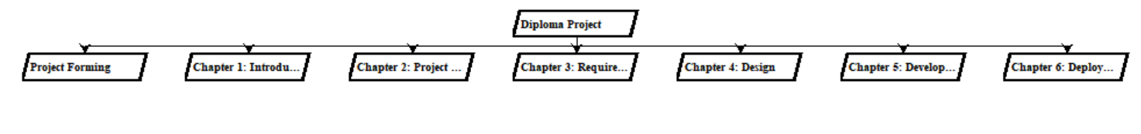
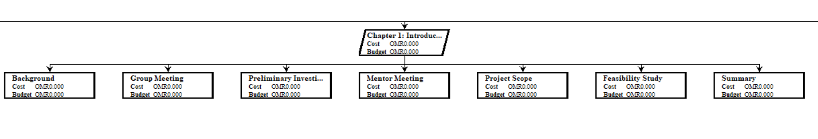
Work Breakdown Structure
Planning → Chapter 1: Overview & Background → Chapter 2: Project Plan → Chapter 3: Requirement Gathering & Analysis → Chapter 4: Design → Chapter 5: Development & Evaluation → Chapter 6: Conclusion & Recommendations → Final Report Compilation → Submission & Presentation

Slide 12
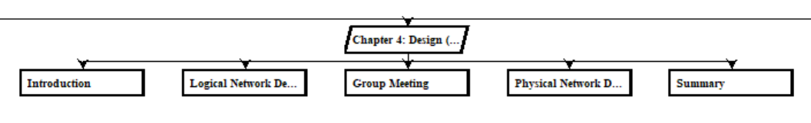

Slide 13
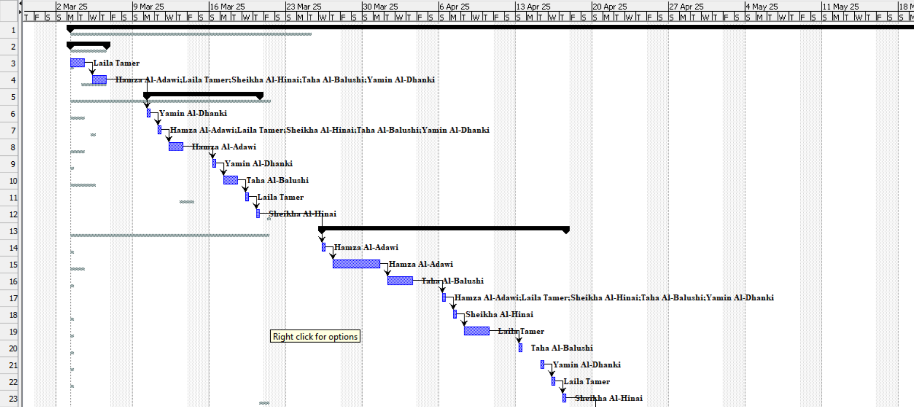
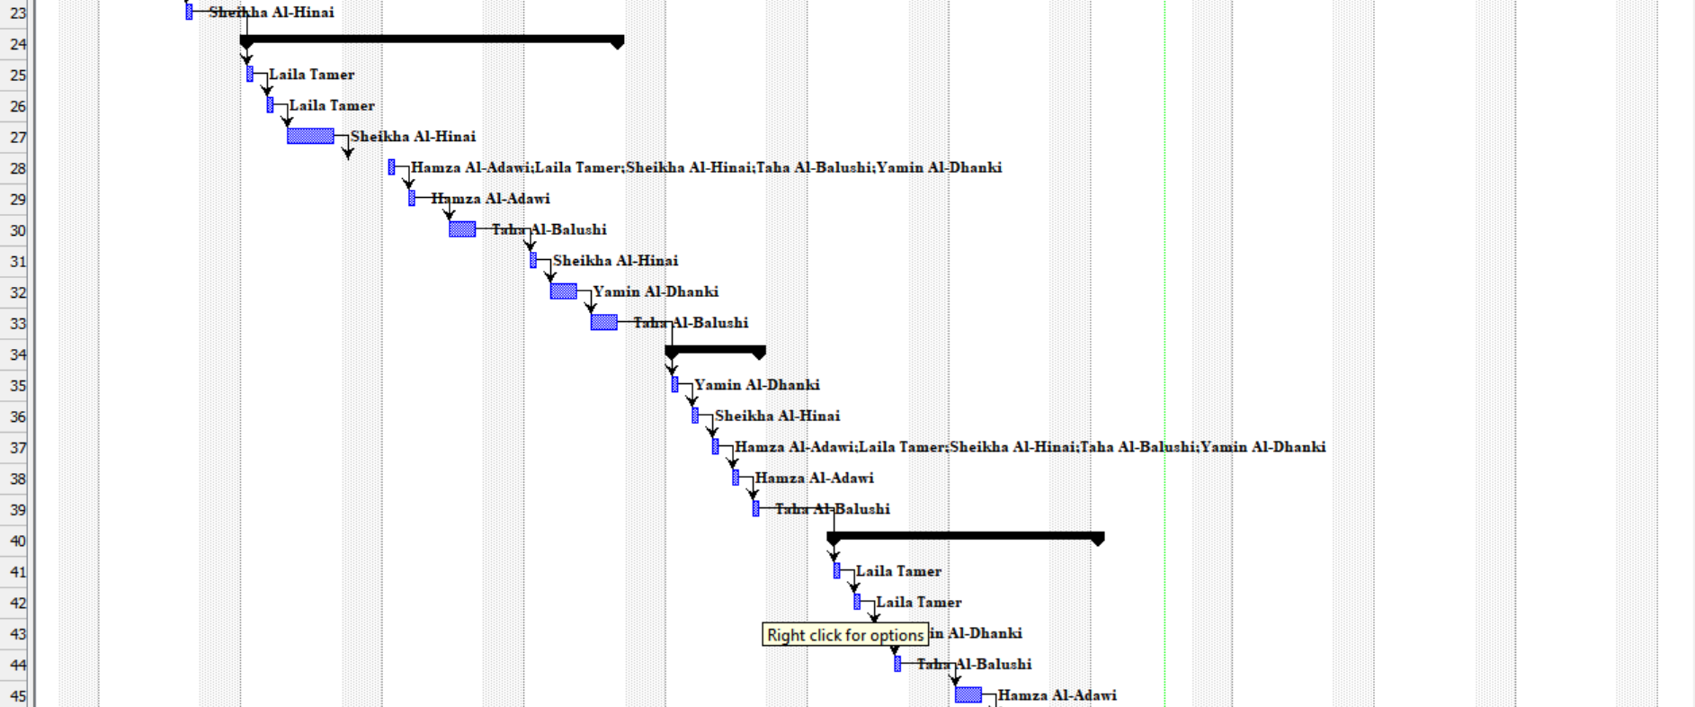
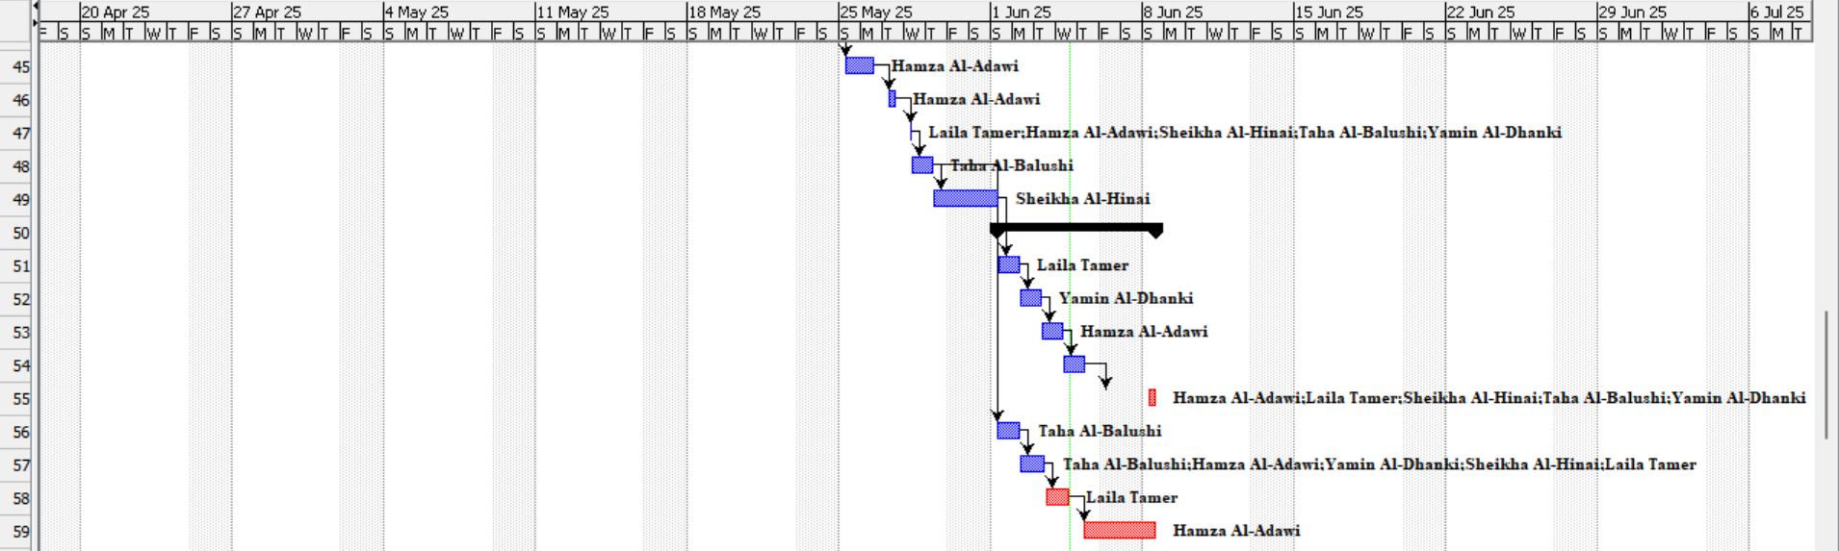
Gantt Chart

Slide 14
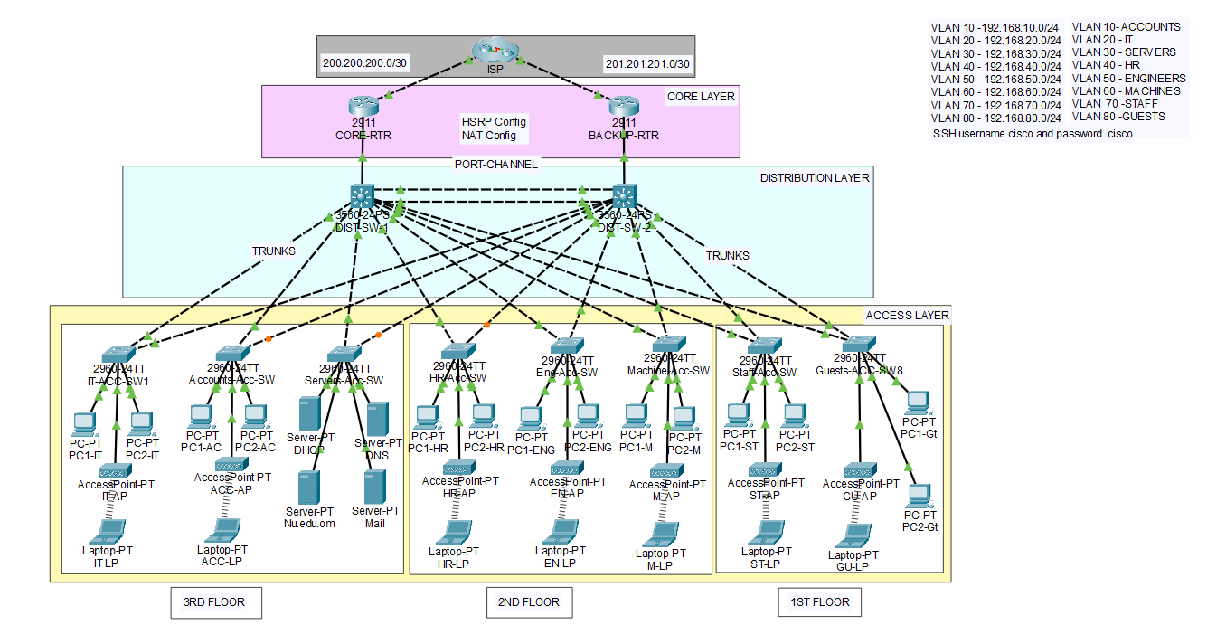
Network Design – Logical View
VLANs for Accounts (10), IT (20), Servers (30), HR (40), Engineers (50), Machines (60), Staff (70), Guests (80)
HSRP for each VLAN interface (active/standby)
ACL “BLOCK-GUEST” applied to guest VLAN

Slide 15
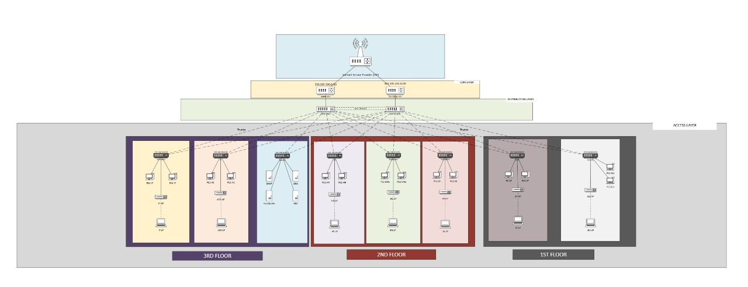
Network Design – Physical View
Core router connected to distribution switches via fiber
Distribution switches uplink to access switches in labs
Access switches to PCs, printers and APs

Slide 16
Deployment
Apply ACLs and port security on access switches
Enable DHCP, DNS and NAT services on servers
Install SNMP monitoring and SSH for remote access
Deploy VLANs and HSRP on routers → configure trunks on switches
Conduct training sessions and collect feedback

Slide 17

Team Reflections
Laila: Applied VLANs, ACLs & enhanced risk management skills
Yamen: Improved technical skills & emphasized cybersecurity awareness
Taha: Gained expertise in network design & visual documentation
Sheikha: Strengthened practical networking skills & teamwork
Hamza: Led planning, explored attack defences & improved leadership

Slide 18
Future Enhancement
AI-driven attack modules
Continuous training content updates
IoT and cloud-based attack scenarios
Contribution to Oman’s digital transformation goals

Slide 19
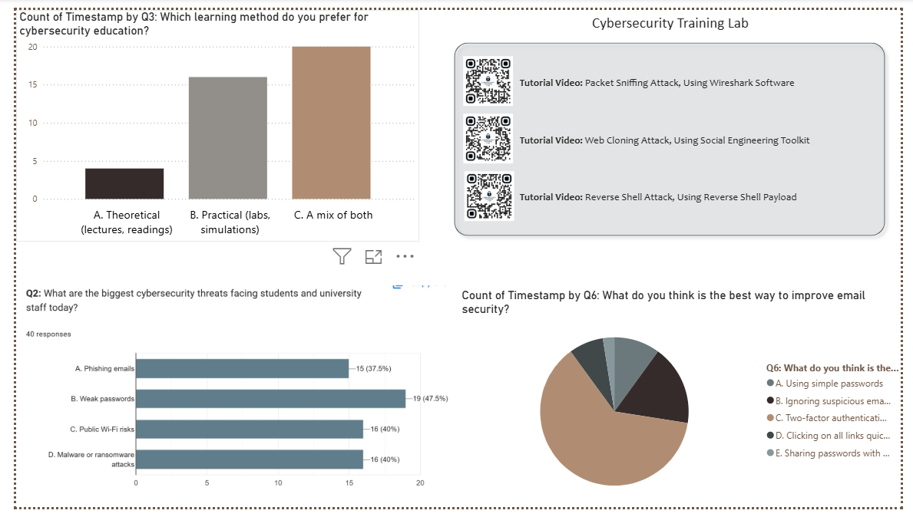
Project Dashboard

Slide 20
Conclusions
Hands-on lab bridges the theory-practice gap
Prepares NU students & staff for real threats
Scalable, maintainable, aligned with national goals

Slide 21
References
Beuran, R., Tang, D., Pham, C., Chinen, K., Tan, Y., & Shinoda, Y. (2018). Integrated framework for hands-on cybersecurity training: CyTrONE. Computers & Security, 78, 350–364. https://doi.org/10.1016/j.cose.2018.07.008
Chowdhury, M. M. H., Colley, S., Abdelgadir, A., & Gabrys, B. (2021). Modeling effective cybersecurity training frameworks: A Delphi method-based study. Computers & Security, 105, Article 102551. https://doi.org/10.1016/j.cose.2021.102551
Jin, G., Tu, M., Kim, T.-H., Heffron, J., & White, J. (2018). Game-based cybersecurity training for high school students. In Proceedings of the 49th ACM Technical Symposium on Computer Science Education (SIGCSE ’18) (pp. 68–73). Association for Computing Machinery. https://doi.org/10.1145/3159450.3159591
Prümmer, J., van Steen, T., & van den Berg, B. (2023). A review of cybersecurity training strategies in the current research landscape. Computers & Security, 112, Article 102458. https://doi.org/10.1016/j.cose.2021.102458

Slide 22
Thank you!
Q&A

